Slide 1



Crop & Fertilizer
recommendation system using ML
AICTE Student ID: STU670691bf4b9a31728483775
AICTE Internship ID:
INTERNSHIP_1733138870674d99b64cb4b

Slide 2

Learning Objectives
Understand ML basics: Learn supervised learning concepts for crop and fertilizer recommendations.
Data Preprocessing: Clean and prepare agricultural data for analysis.
Feature Engineering: Create relevant features for better predictions.
Model Selection: Choose and train the best ML model for recommendations.
Model Evaluation: Assess model performance using metrics like accuracy.
Optimization: Improve model performance with hyperparameter tuning.
Recommendation System: Apply filtering techniques for better crop/fertilizer suggestions.
Deployment: Learn to deploy the model for real-world use.
GOAL
Source :
www.freepik.com/

Slide 3
Tools and Technology used
Programming Language: Python
Libraries:Pandas (Data handling),
NumPy (Numerical operations)Scikit-learn (ML algorithms)Matplotlib/Seaborn (Data visualization)
3. IDE: Jupyter Notebook/VS Code
4. Data Storage: CSV/Excel (for dataset storage)
5. Model Deployment: Flask/FastAPI (for web deployment)
6. Version Control: Git/GitHub
7. Cloud Services (Optional): AWS/Google Cloud (for hosting)

Slide 4
Methodology
Data Collection: Gather a dataset containing agricultural data (e.g., soil type, weather, crop history).
Data Preprocessing: Clean the dataset by handling missing values, encoding categorical data, and scaling numerical features.
Feature Engineering: Identify and create relevant features such as soil quality, temperature, and moisture.
Model Selection: Choose suitable machine learning algorithms (e.g., Decision Trees, Random Forest) for prediction.
Model Training: Split the data into training and testing sets, and train the model on the training data.
Model Evaluation: Evaluate the model using accuracy, precision, recall, or other relevant metrics.
Optimization: Fine-tune the model using techniques like GridSearchCV for hyperparameter optimization.
Recommendation Generation: Implement the trained model to suggest suitable crops and fertilizers based on input data.
Deployment: Deploy the model via a web interface or API for user interaction.
Feedback Loop: Collect user feedback to improve recommendations over time.

Slide 5
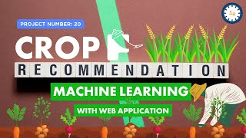
Problem Statement:
The agricultural sector faces challenges in optimizing crop production due to varying soil conditions, climate, and resource availability. Farmers often lack personalized recommendations for the right crops and fertilizers based on their unique environmental conditions. The goal of this project is to develop a machine learning-based recommendation system that accurately suggests suitable crops and fertilizers based on input parameters such as soil type, climate, and historical crop data, thereby improving agricultural productivity and sustainability.

Slide 6
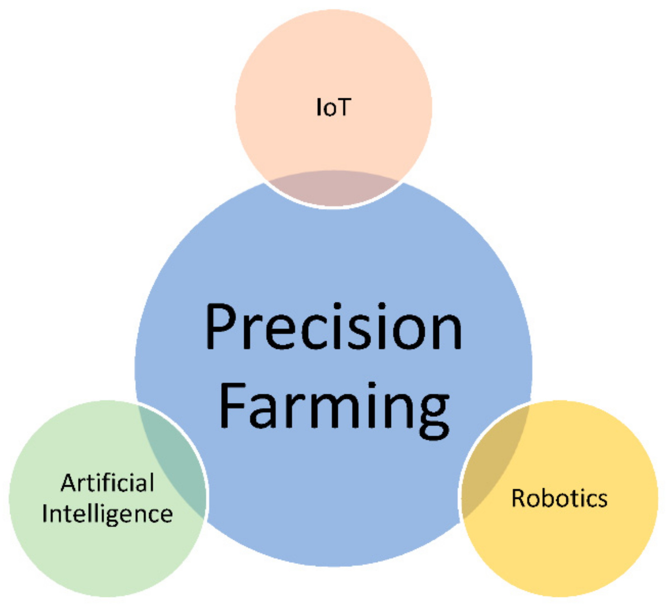
Solution:
1.Data Collection : Farmers input data about their soil type, weather conditions, and past crops.
2. Data Preprocessing : The system cleans and processes the data by handling missing values, encoding categorical data, and scaling numerical features to prepare for modeling.
3. Machine Learning Model : Using algorithms like Random Forest or Decision Trees, the system is trained on historical data to predict the best crop and fertilizer based on the farmer’s input.
4. Recommendation Generation : The trained model recommends the most suitable crop and fertilizer based on the given environmental data.
5. User Interface : Farmers can easily input their data via a simple interface and receive real-time crop and fertilizer recommendations.

Slide 7
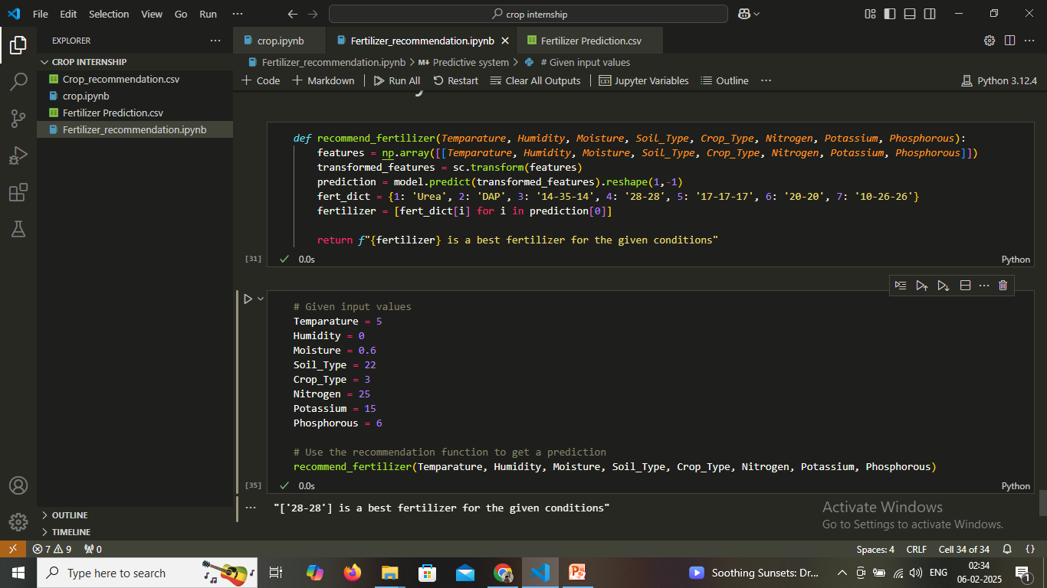
Screenshot of Output:

Slide 8
Conclusion:
The crop and fertilization recommendation system offers a practical solution to the challenges faced by farmers in selecting the right crops and fertilizers for their specific conditions. By integrating machine learning algorithms, the system uses data on soil type, climate, and historical crop performance to deliver accurate and personalized recommendations. This helps farmers optimize their decisions, resulting in increased crop yield, improved resource utilization, and reduced environmental impact.
Through a simple user interface, farmers can easily input their local conditions, and the system will provide real-time suggestions on which crops to plant and the appropriate fertilizers to use. The system not only supports sustainable farming by ensuring the right crop is chosen for the given environment but also promotes efficient fertilizer use, preventing overuse or underuse, which can harm the soil and the environment.
In conclusion, this project brings a data-driven approach to agriculture, allowing farmers to make informed decisions that can lead to higher productivity, reduced costs, and better long-term sustainability. With continuous updates and feedback loops, the system can further evolve, offering even more precise recommendations as new data is integrated.

